Slide 1
Weka Diabetes Analysis
By:
Canhong Huang
Brenden McCabe

Slide 2
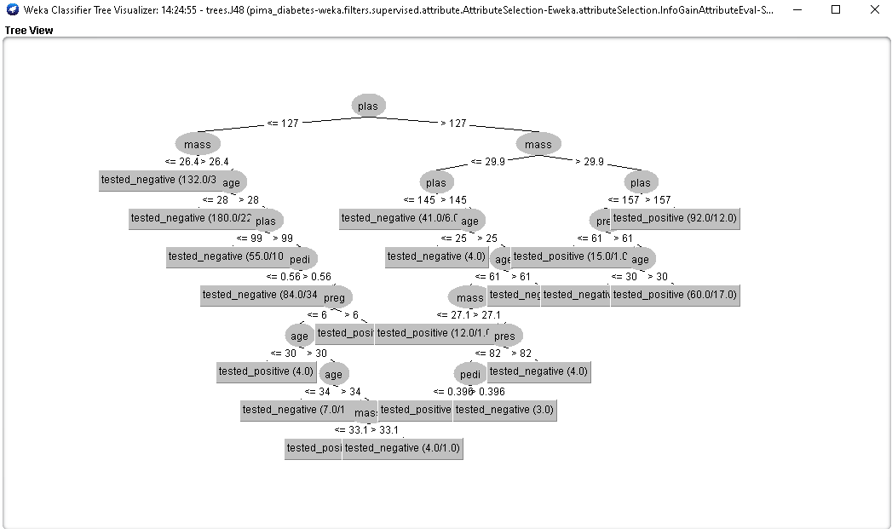
Diabetes Data Tree
This tree has been given multiple sets of training data constructed by past medical records to determine if a patient tests positive or negative for diabetes.
The training data is accompanied by a bunch of different features that are often used to prove if a patient does in fact have diabetes.
The dataset was loaded into the Weka: Machine Learning Software, which created this tree.
The features with the least amount of entropy are located at the top of the tree.

Slide 3
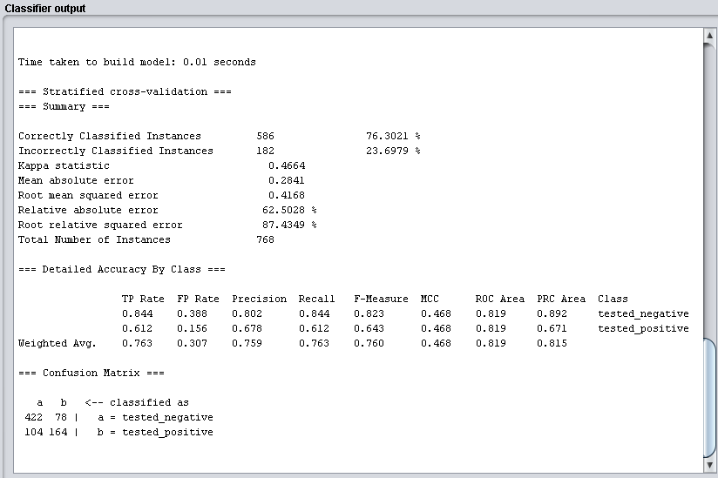
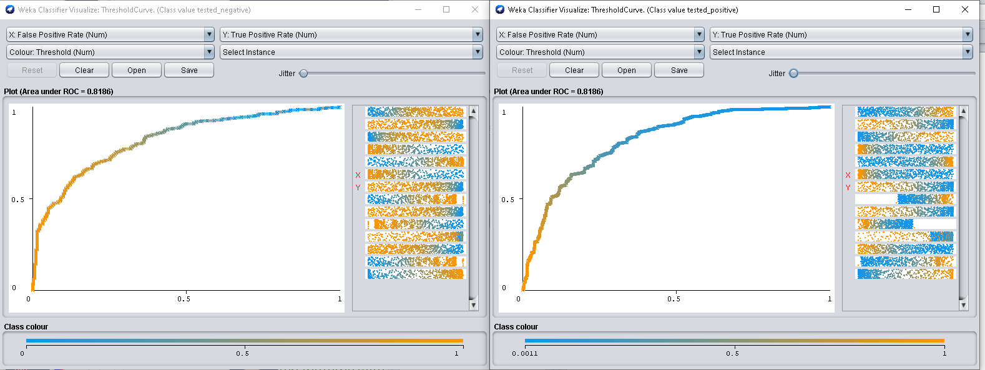
Receiver Operating Characteristic (ROC) Curves
From a total of 768 patient instances, we were able to break them down into two separate classes “tested_negative” or “tested_positive”.
The F-Measure indicates the measure of a model’s accuracy on a dataset. For the given dataset our F-Measure is:
0.823 for “tested_negative”
0.678 for “tested_positive”
0.760 as a weighted average of the data
The area under the ROC curve tells us how well this data allows us to distinguish between the two given classes. Our area under the curve is:
0.8186
Negative Positive

Slide 4
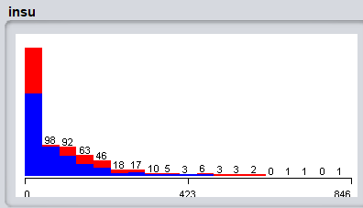
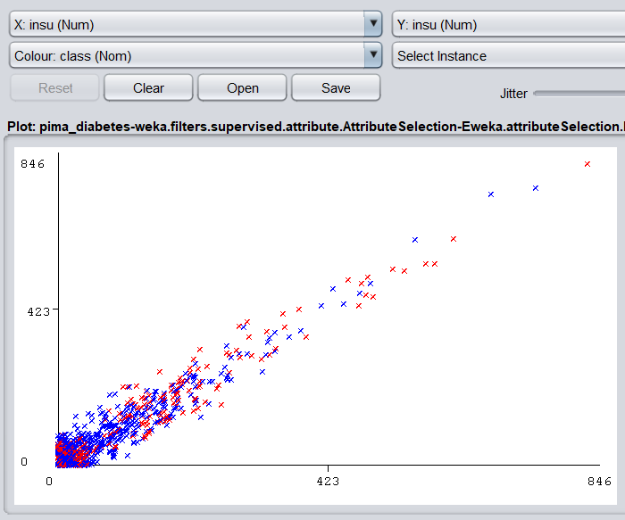
Insu
Average insu 79.8
The percentage of being tested positive is high when the insu is low.
As the insu increased, the population of patients who tested positives decreased dramatically.
A patient is more likely to test positive at a lower insu.

Slide 5
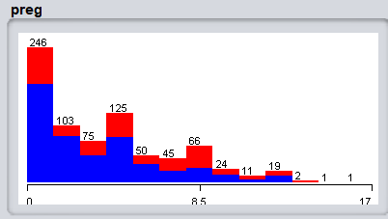
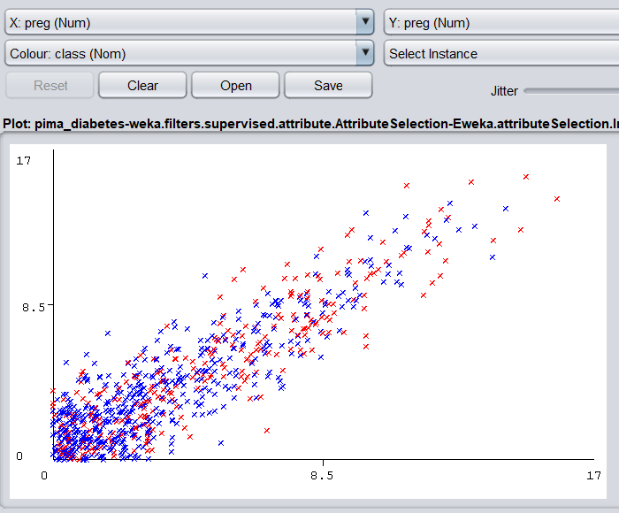
Preg
Average preg 3.85
The percentages of being tested positive are high in the range 0 - 8.5 in the grapgh.
The amount of being tested positive is larger when the preg is lower than average.
A patient have higher chance to test positive at lower level of preg.

Slide 6
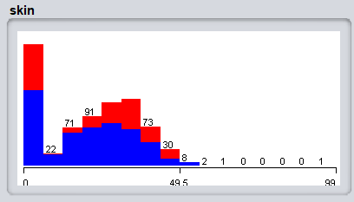
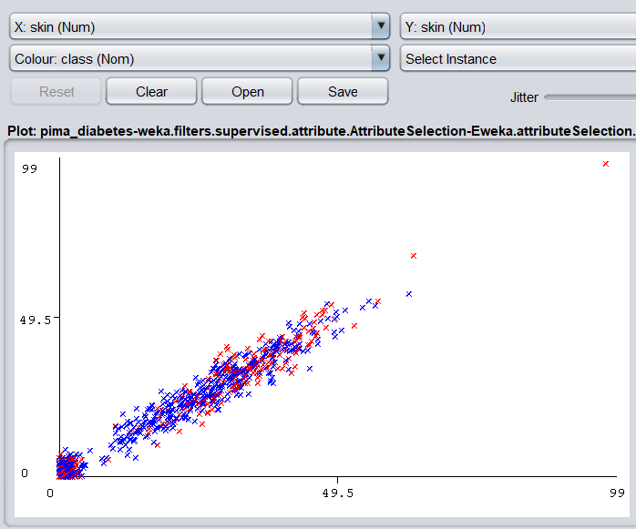
Skin
Average skin 20.54
The percentage of being tested positive is pretty high in 1st bar, which is low in skin. And in other bar it represents some symmetric pattern at the range between 12(approximately) to 49.5 in the graph.
There is a strange gap at the range 6 -12(approximately), in that particular gap we barely see positive cases.
A patient have high chance to test positive at the lowest level of skin..

Slide 7
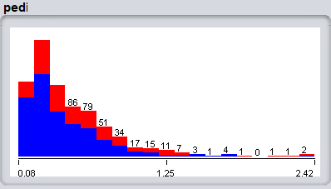
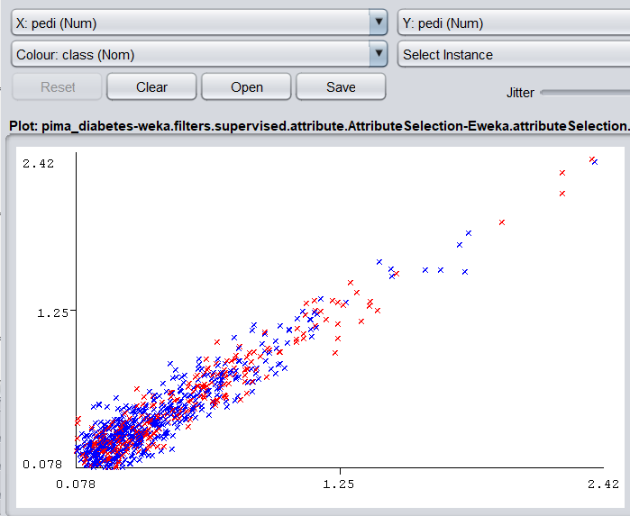
Pedi
Average pedi 0.47
The percentage of being tested positive is high when pedi is low.
The amount of patients drop dramatically as the pedi increased.
A patient have high chance to test positive at lower level of pedi.

Slide 8
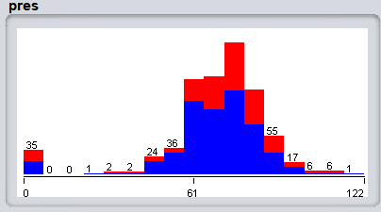
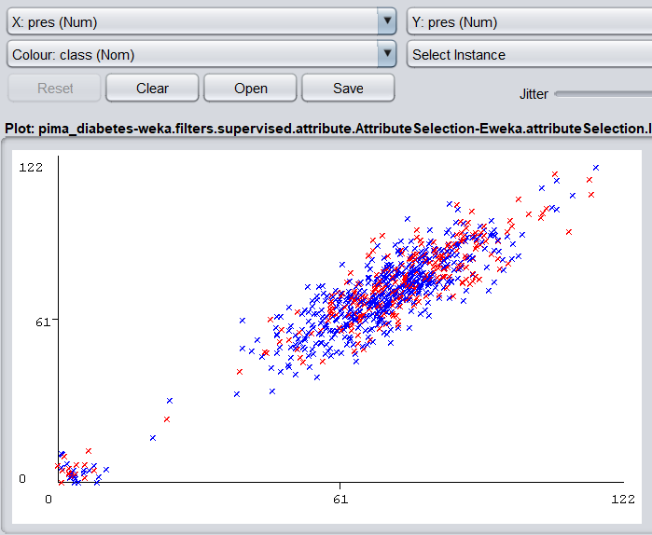
Pres
Average pres 69.11
The percentage of being tested positive is pretty high when the pres is high. And most of the cases centered around the range of 60-90(approximately).
There is a huge gap between 1st bar and the bars in the range of 46-90(approximately).
A patient have high chance to test positive at high level of pres, and also have a decent chance to tested positive when the pres is extremely low.

Slide 9
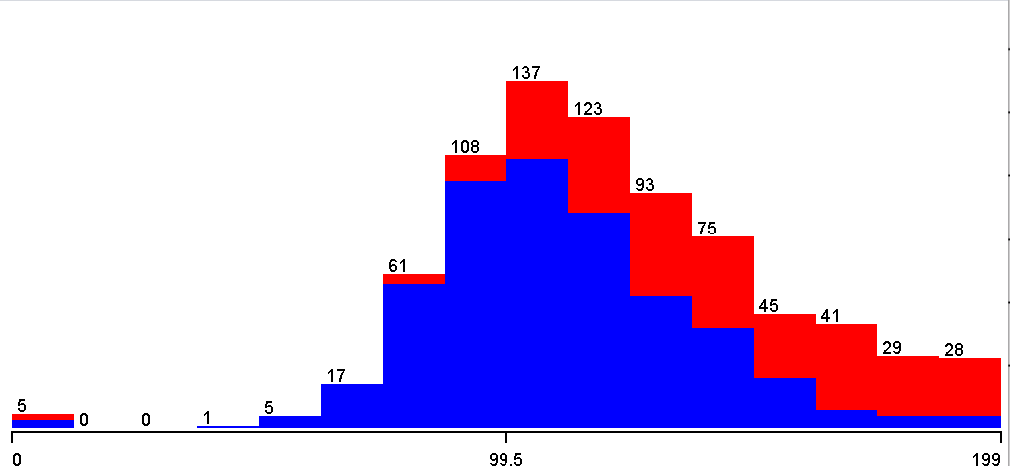
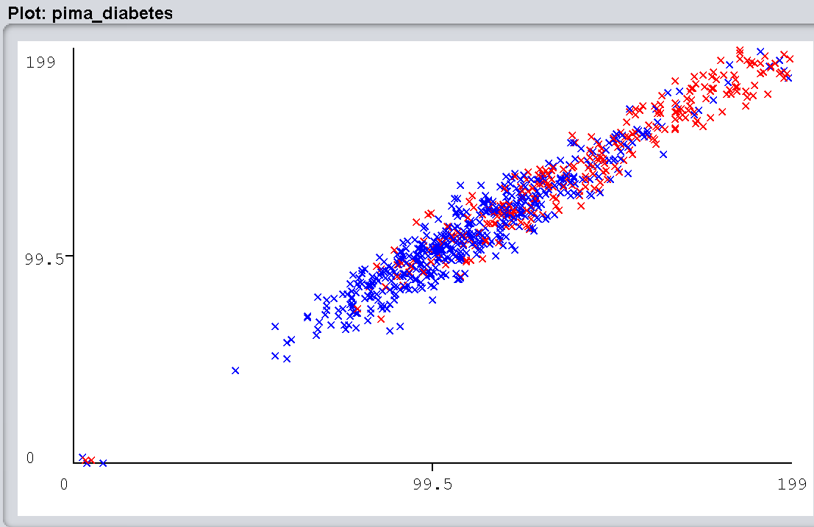
Plas
Average plas 120.9
If the plas is higher than the average in a patient the result is almost always positive.
Otherwise, if the plas is lower than average the result is most likely negitive.
A patient have high chance to test positive at high level of plas.

Slide 10
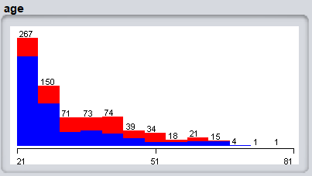
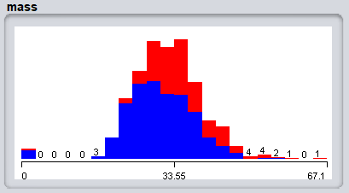
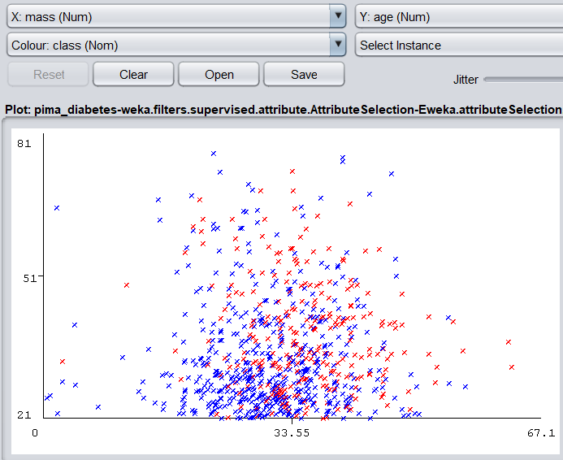
Age over Mass
Average age 33.2
Average mass 32.0
The percentage of being tested positive increased as the age increased(from 21 to 51). The population of older age is lower than people with young age, and the percentage of positive decreased..
As the mass increased, the percentage of tested positives increased, in other words, people have higher chance to tested positive if their mass is high.
A patient is more likely to test positive at a older age and/or overweight.

Slide 11
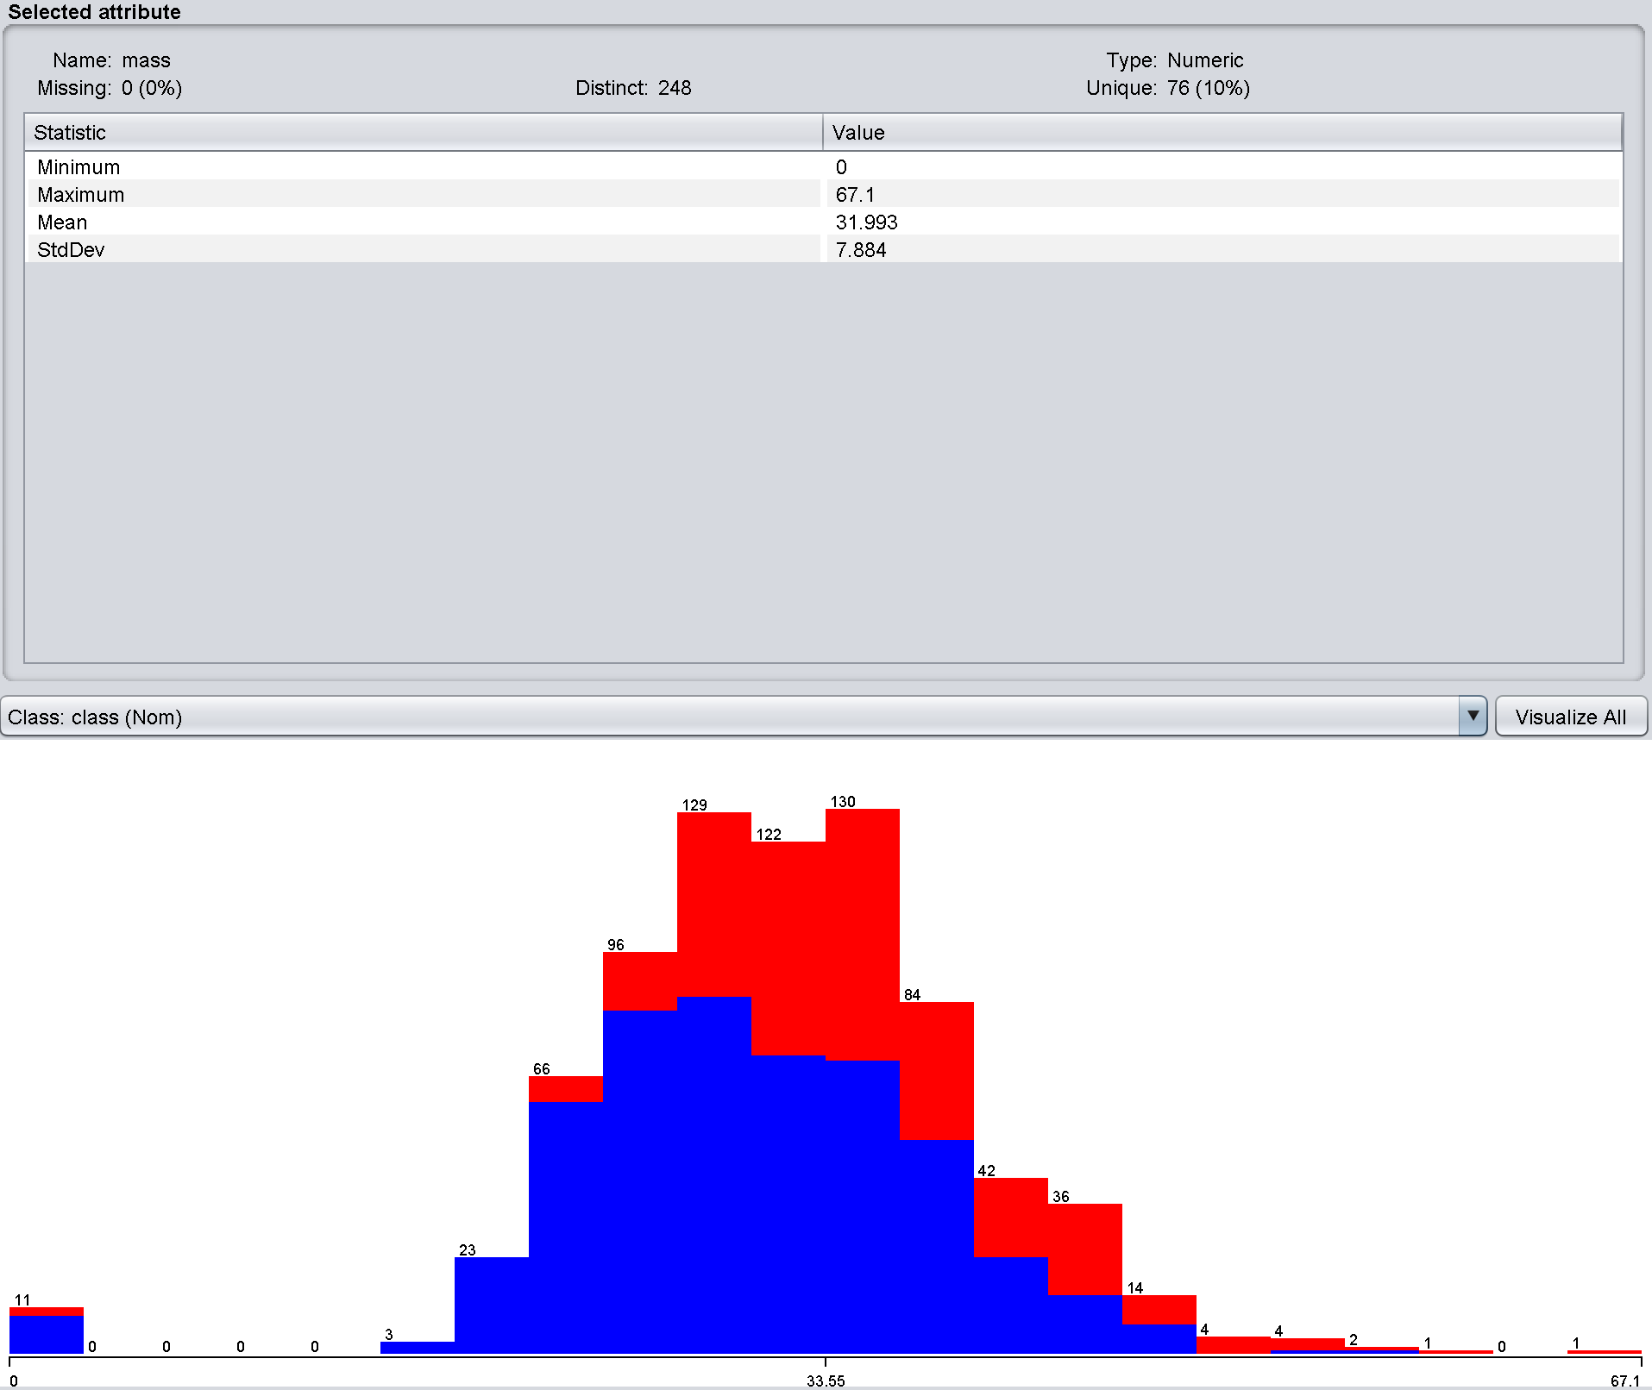
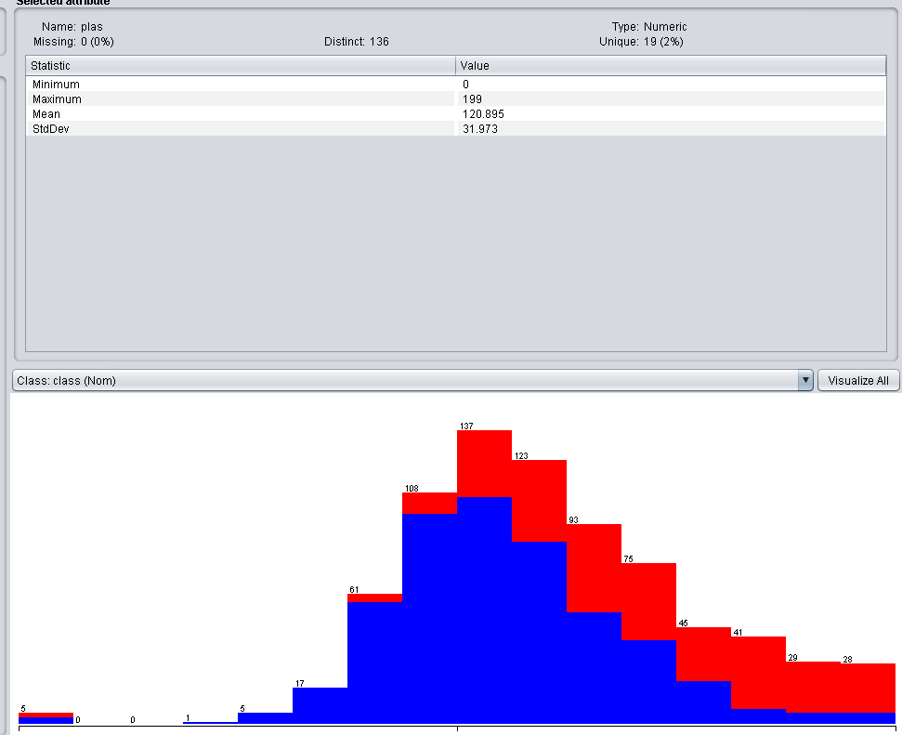
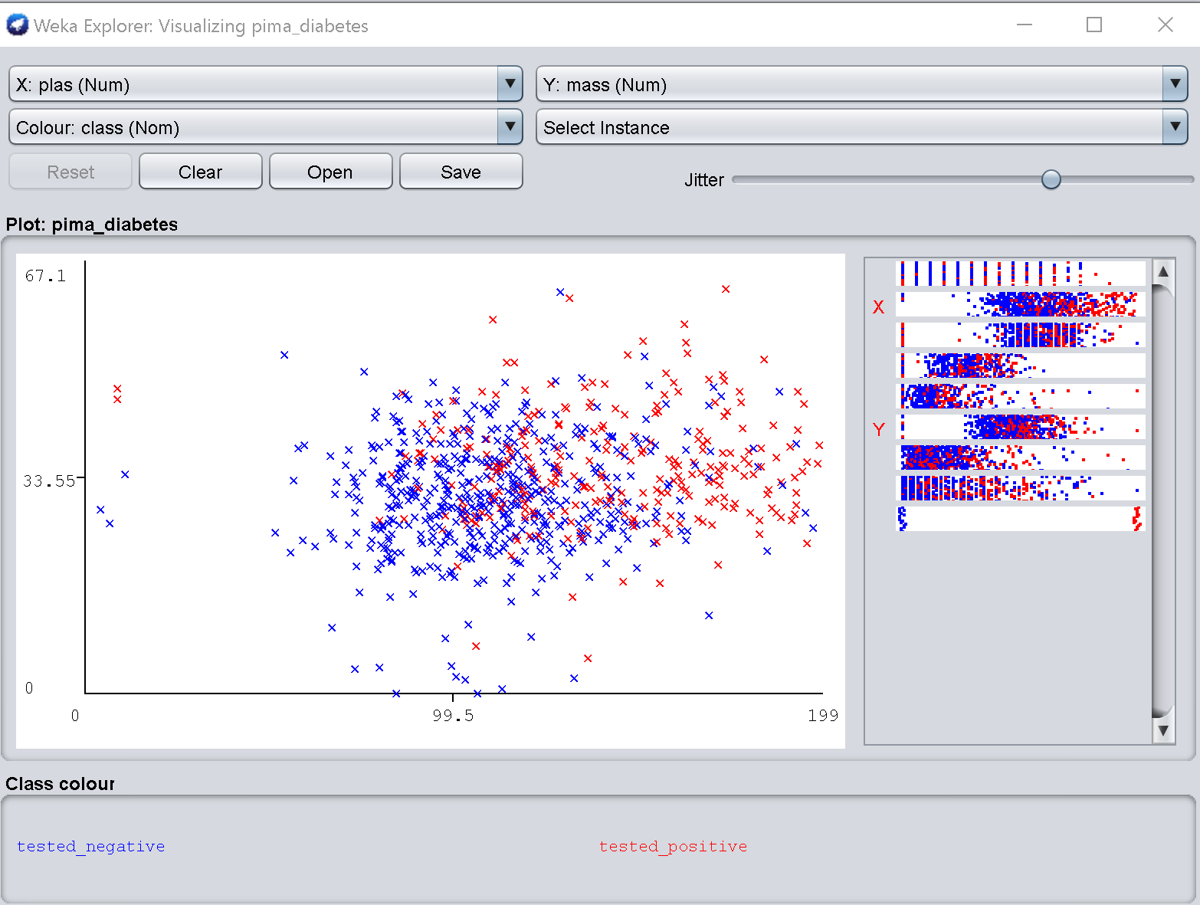
Mass Over Plas
Average mass 32
Average plas 120.9
A lower than average plas count in all size patients reveals a higher chance of a negative result.
A higher than average plas count in over sized patients reveals a higher chance of a positive result.
A higher than average mass and/or plas does increase your chances of testing positive.
Mass Plas

Slide 12
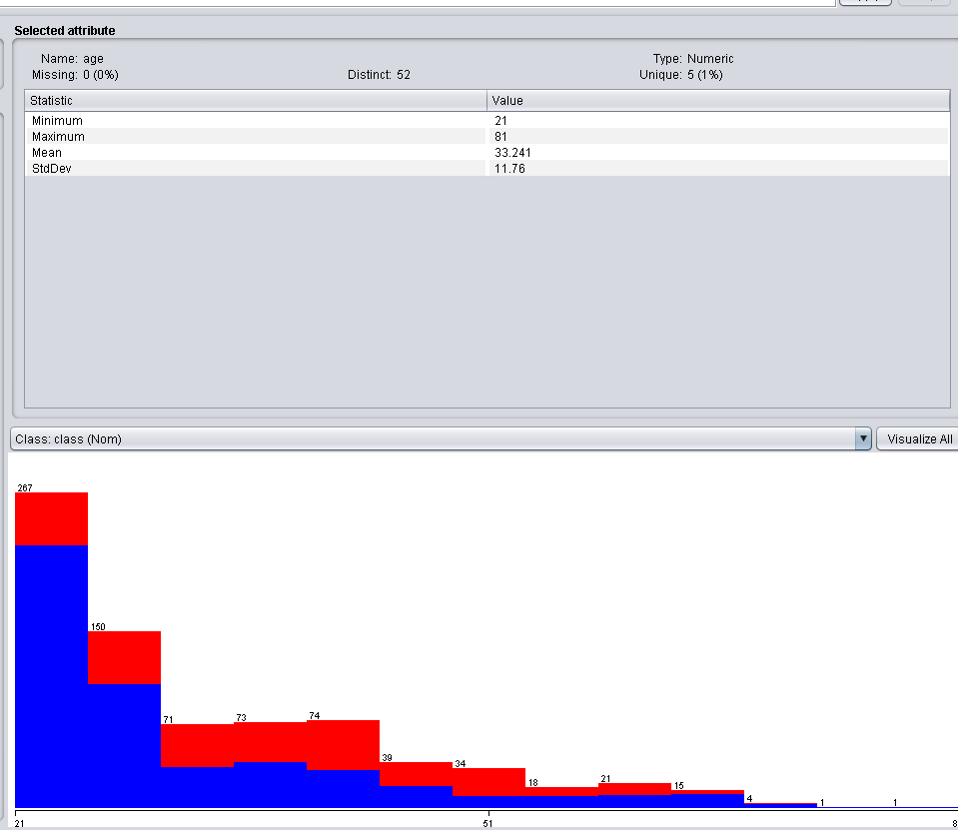
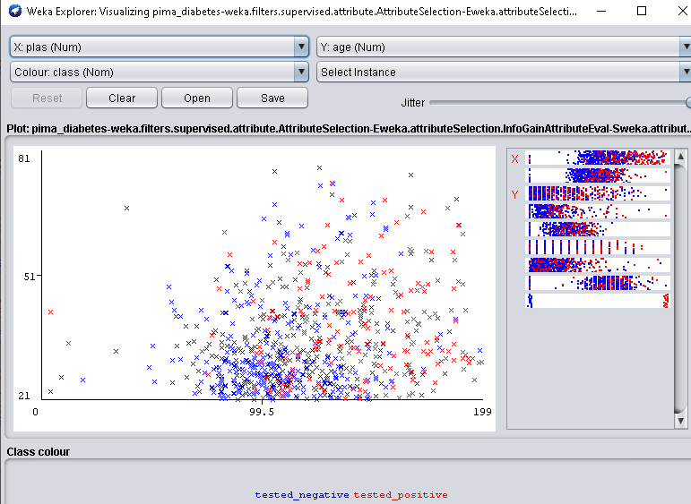
Age Over Plas
Average age 33.2
Average plas 120.9
A lower than average plas count in younger patients reveals a very high chance of a negative result.
A higher than average plas count in older aged patients reveals a higher chance of a positive result.
A patient is more likely to test positive when their plas is high, and their age is around our average or higher.
Age Plas

Slide 13
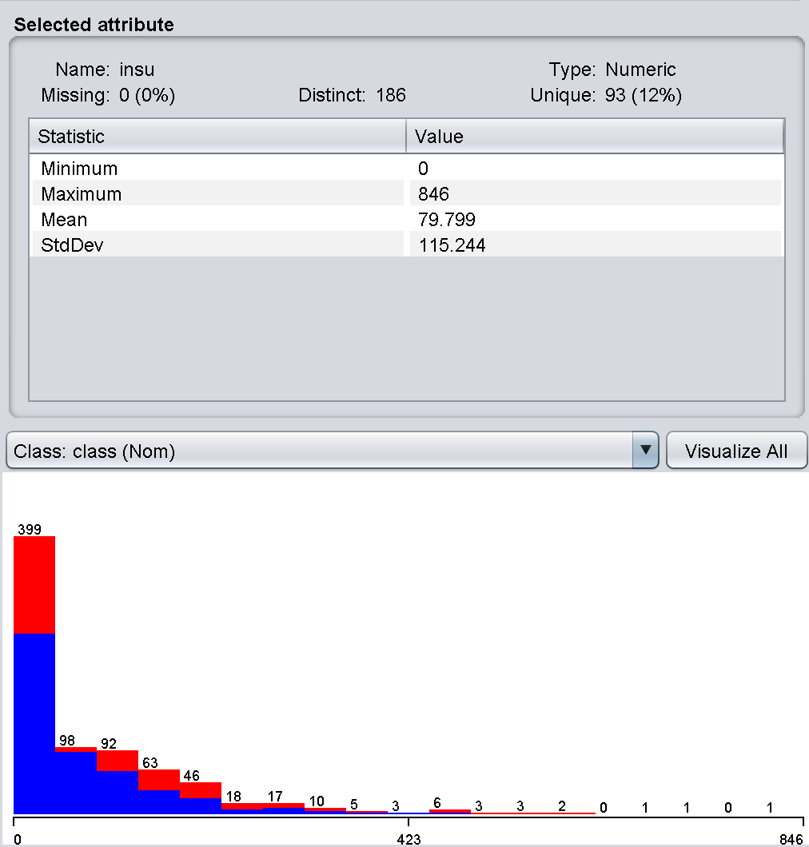
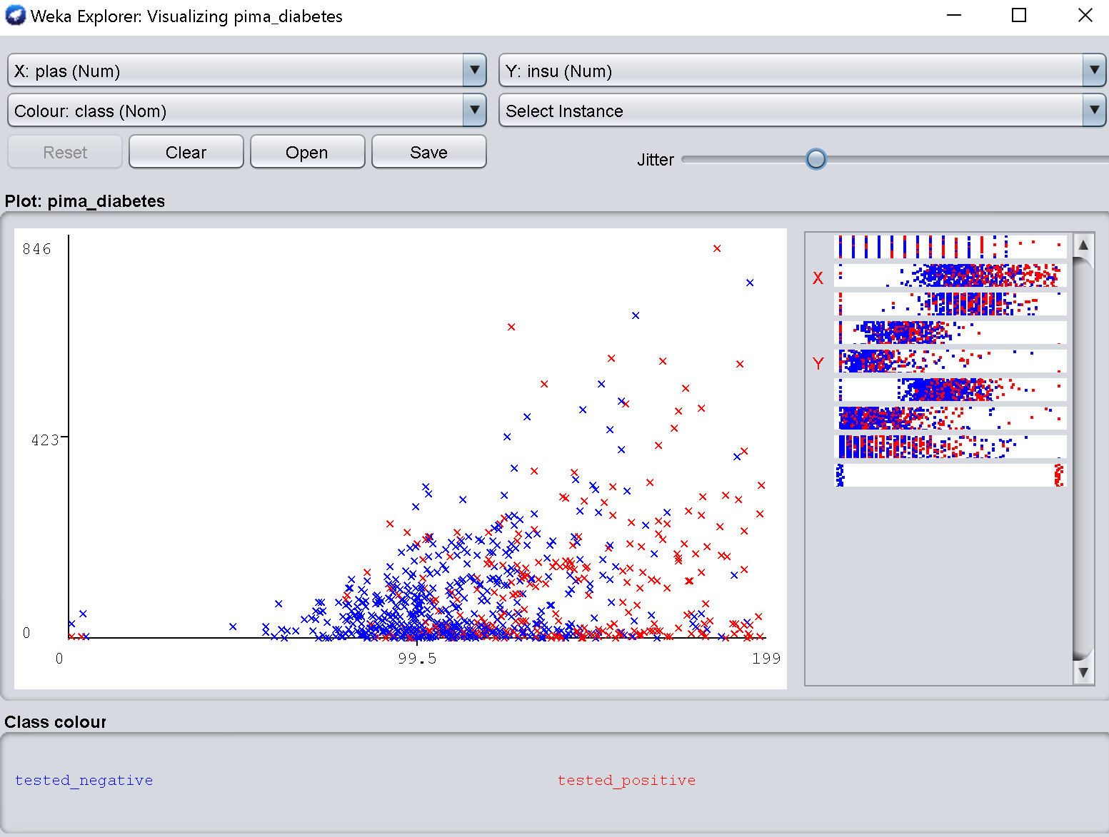
Insu Over Plas
Average insu 79.8
Average plas 120.9
A lower than average plas count in patients with an average amount of insu reveals a very high chance of a negative result.
A higher than average plas count in all patients no matter the insu levels gives a very high chance of a positive result.
A patient who has a low insu and a plas around our average has a high chance of positivity. Also, if the patient’s plas is higher than our average their insu could be high or low and still result in positive.
Insu Plas

